Slide 1


Dept. of Computer Science & Engineering.
Assignment 9
PHP Cookies
PLD
Prepared By
Prof. A. R. Uttarkar
Assistant Professor
CSE Department, MIT SOE

Slide 2
Cookie
What is a Cookie?
A cookie is often used to identify a user. A cookie is a small file that the server embeds on the user's computer. Each time the same computer requests a page with a browser, it will send the cookie too. With PHP, you can both create and retrieve cookie values.
Create Cookies With PHP- is created with the setcookie() function.
Syntax
setcookie(name, value, expire, path, domain, secure, httponly);
Only the name parameter is required. All other parameters are
optional.

Slide 3
PHP Cookies
What is a Cookie?
A cookie is often used to identify a user.
A cookie is a small file that the server embeds on the user's computer.
Each time the same computer requests a page with a browser, it will send the cookie too.
Cookies are a mechanism for storing data in the remote browser and thus tracking or identifying return users.
In PHP, you can both create and retrieve cookie values.
A cookie is created using setcookie(). The setcookie() function must appear BEFORE the <html> tag i.e. before any output is sent to the browser..

Slide 4
setcookie() Syntax: setcookie(name, value, expire, path, domain, secure, httponly);
Parameter | Description
Name | The name of the cookie.
Value | The value of the cookie. This value is stored on the clients computer; do not store sensitive information. Retrieved through $_COOKIE['cookiename']
Expire | The time the cookie expires. (Unix timestamp so is in number of seconds) use mktime() - time()+60*60*24*30 will set the cookie to expire in 30 days. If set to 0, or omitted, the cookie will expire at the end of the session (when the browser closes).
Path | The path on the server in which the cookie will be available on. If set to '/', the cookie will be available within the entire domain. If set to '/foo/', the cookie will only be available within the /foo/ directory and all sub-directories.
Domain | The (sub)domain that the cookie is available to. ('www.example.com')
Secure | Indicates that the cookie should only be transmitted over a secure HTTPS connection from the client. Set to TRUE for secure connection.
httponly | When TRUE the cookie will be made accessible only through the HTTP protocol. This means that the cookie won't be accessible by scripting languages, such as JavaScript.

Slide 5

PHP Cookies
How to Retrieve a Cookie Value?
The PHP $_COOKIE variable is used to retrieve a cookie value.
Find out if a cookie has been set?
isset() function
How to delete a cookie?
Use the setcookie() function with an expiration date in the past.
How to check if cookies are enabled?
Using count() of #of cookies
<?php // Print an individual cookie echo $_COOKIE["TestCookie"]; // Another way to debug/test is to view all cookies print_r($_COOKIE); ?>
<?php setcookie("test_cookie", "test", time() + 3600, '/'); ?> <html>
<html> <body> <?php if(count($_COOKIE) > 0) echo "Cookies are enabled."; ?> </body></html>

Slide 6
Cookie-Create/Retrieve a Cookie
<?php
setcookie(“name”, “Amit”, time() + (86400 * 30), "/"); // 86400 = 1 day
?>
<html>
<body>
<?php
if(isset($_COOKIE[“name”]))
{
$nm=$_COOKIE[“name”];
echo “Hello”,$nm;
}
else { echo “Coocke is not set”; }
?>
</body>
</html>

Slide 7
Cookie- Deleting Cookies
<?php
// set the expiration date to one hour ago
setcookie("user", "", time() - 3600);
?>
<html>
<body>
<?php
echo "Cookie 'user' is deleted.";
?>
</body>
</html>

Slide 8
Sessions
A session is a way to store information (in variables) to be used
across multiple pages.
Unlike a cookie, the information is not stored on the users computer.
What is a PHP Session?
When you work with an application, you open it, do some changes, and then you close it. This is much like a Session. The computer knows who you are. It knows when you start the application and when you end. But on the internet there is one problem: the web server does not know who you are or what you do, because the HTTP address doesn't maintain state.
Session variables solve this problem by storing user information to be used across multiple pages (e.g. username, favorite color, etc). By default, session variables last until the user closes the browser.
So; Session variables hold information about one single user, and are available to all pages in one application.

Slide 9
PHP Sessions
A session is a way to store information (in variables) to be used across multiple pages.
Unlike a cookie, the information is not stored on the users computer.
A PHP session variable is used to store information about, or change settings for a user session. Session variables hold information about one single user, and are available across multiple pages in one application.
Sessions work by creating a unique id (UID) for each visitor and store variables based on this UID. The UID is either stored in a cookie or is propagated in the URL.
Starting a PHP Session
A session is started with the session_start() function.
Session variables are set with the PHP global variable: $_SESSION.
The session_start() function must appear BEFORE the <html> tag.
<?php session_start(); ?> <html> <body>

Slide 10
Sessions- Start a Session
A session is started with the session_start() function.
Session variables are set with the PHP global variable: $_SESSION.
Example - demo_session1.php
<?php
session_start(); // Start the session ?>
<html>
<body>
<?php
$_SESSION["favcolor"] = "green"; // Set session variable
echo "Session variables are set."; ?>
</body>
</html>

Slide 11
Sessions: Get Session Variable Values
Next, we create another page called "demo_session2.php". From this page, we will access the session information we set on the first page ("demo_session1.php").
session variable values are stored in the global $_SESSION variable
Example- demo_session2.php
<?php
session_start(); ?>
<html>
<body>
<?php
// Echo session variables that were set on previous page
echo "Favorite color is " . $_SESSION["favcolor"];
?>
</body>
</html>

Slide 12
Sessions- Modify a Session
To change a session variable, just overwrite it:
<?php
session_start(); ?>
<html>
<body>
<?php
// to change a session variable, just overwrite it
$_SESSION["favcolor"] = "yellow"; print_r($_SESSION);
?>
</body>
</html>

Slide 13
Sessions: Destroy a Session
To remove all global session variables and destroy the session, use
session_unset() and session_destroy():
Example-
<?php
session_start(); ?>
<html>
<body>
<?php session_unset(); session_destroy();
?>
// remove all session variables
// destroy the session
</body>
</html>

Slide 14
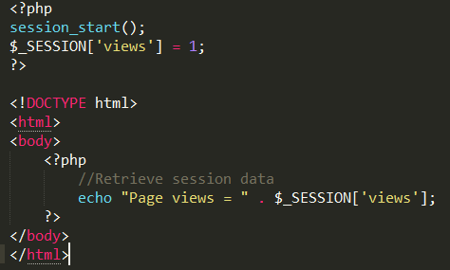
PHP Sessions
The session id is sent to the user when his session is created. it is stored in a cookie (called, by default, PHPSESSID ) that cookie is sent by the browser to the server with each request. the server (PHP) uses that cookie, containing the session_id, to know which file corresponds to that user.
Created session → stored in cookie PHPSESSID → sent to server with each request
Storing a Session Variable
The correct way to store and retrieve session variables is to use the $_SESSION variable.

Slide 15
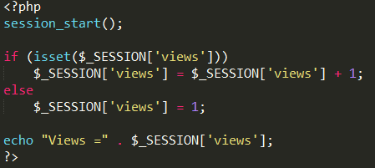
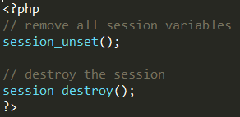
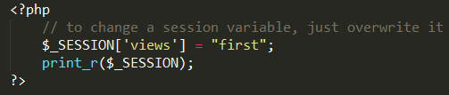
PHP Sessions http://php.net/manual/en/book.session.php
The isset() function checks if the "views" variable has already been set.
Destroying a Session unset() or the session_destroy()
Modify a Session overwrite it using $_SESSION[]=new value

Slide 16
Assignment Title
Write a PHP script to create cookie of color.
What Student Have to Perform
Using Appropriate Syntax as Explained in Pervious Slides write a PHP Script for Cookie Value and Session Handling
Take User input as Favorite Color name
Output Will be Chosen Colored Background

Slide 17
THANK YOU

